Slide 1
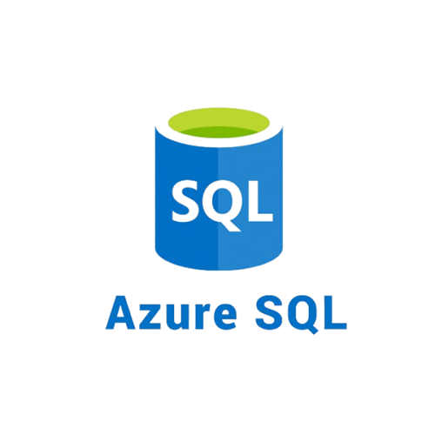
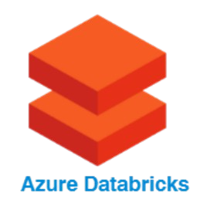
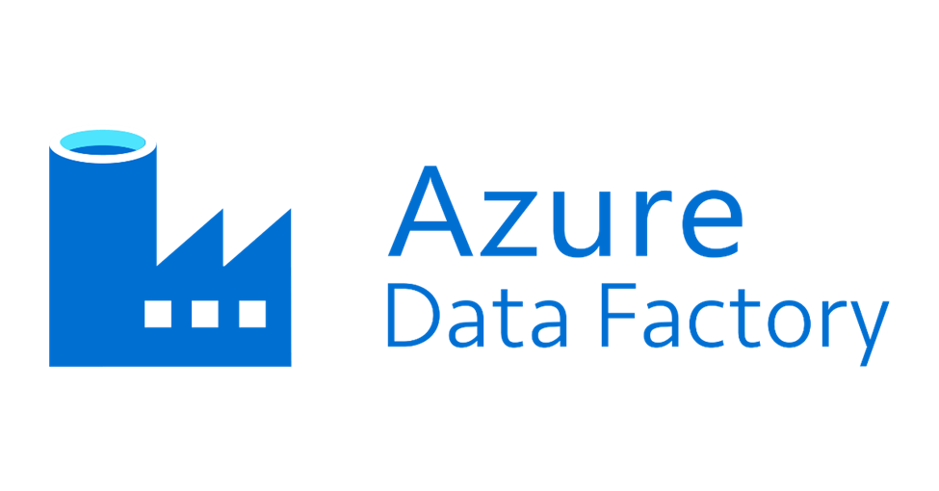
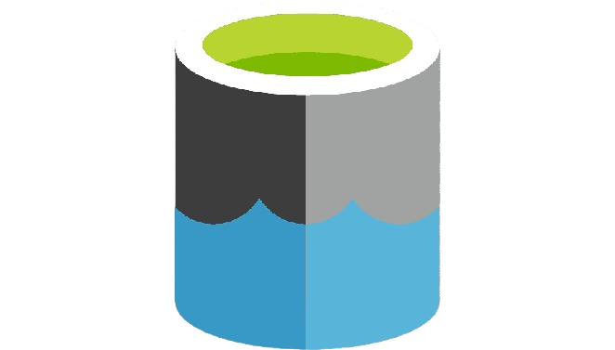
Specialization: Data Engineering
Business Focus: Health Sector
Tool: Azure Cloud
NATIONAL HOSPITAL
Project Learning Opportunities
Leverage Azure cloud to build efficient and scalable data pipelines for a hospital to solve the problem of data silos, and support business analytics and data-driven decision making.
Tools and Technology to be Used
Azure Datal Lake
Storage Gen2

Slide 2
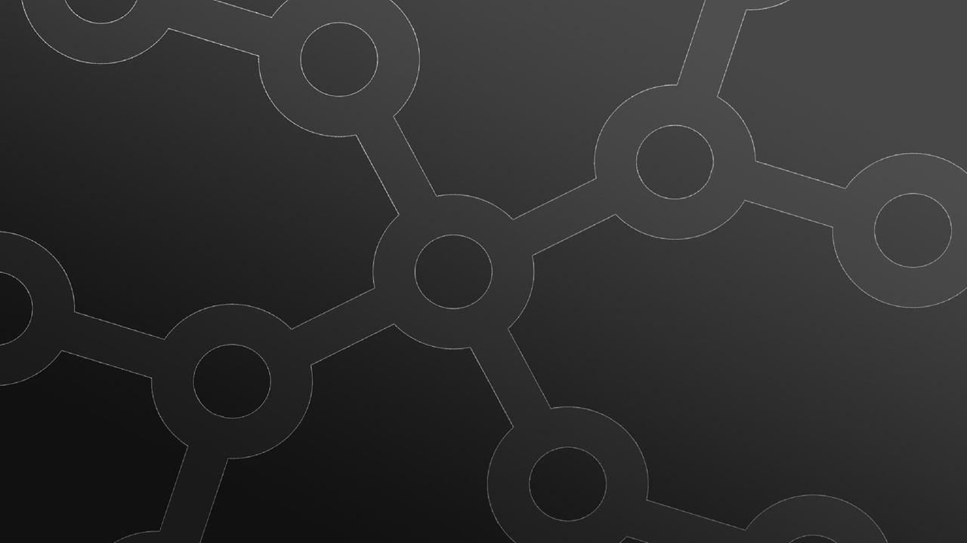

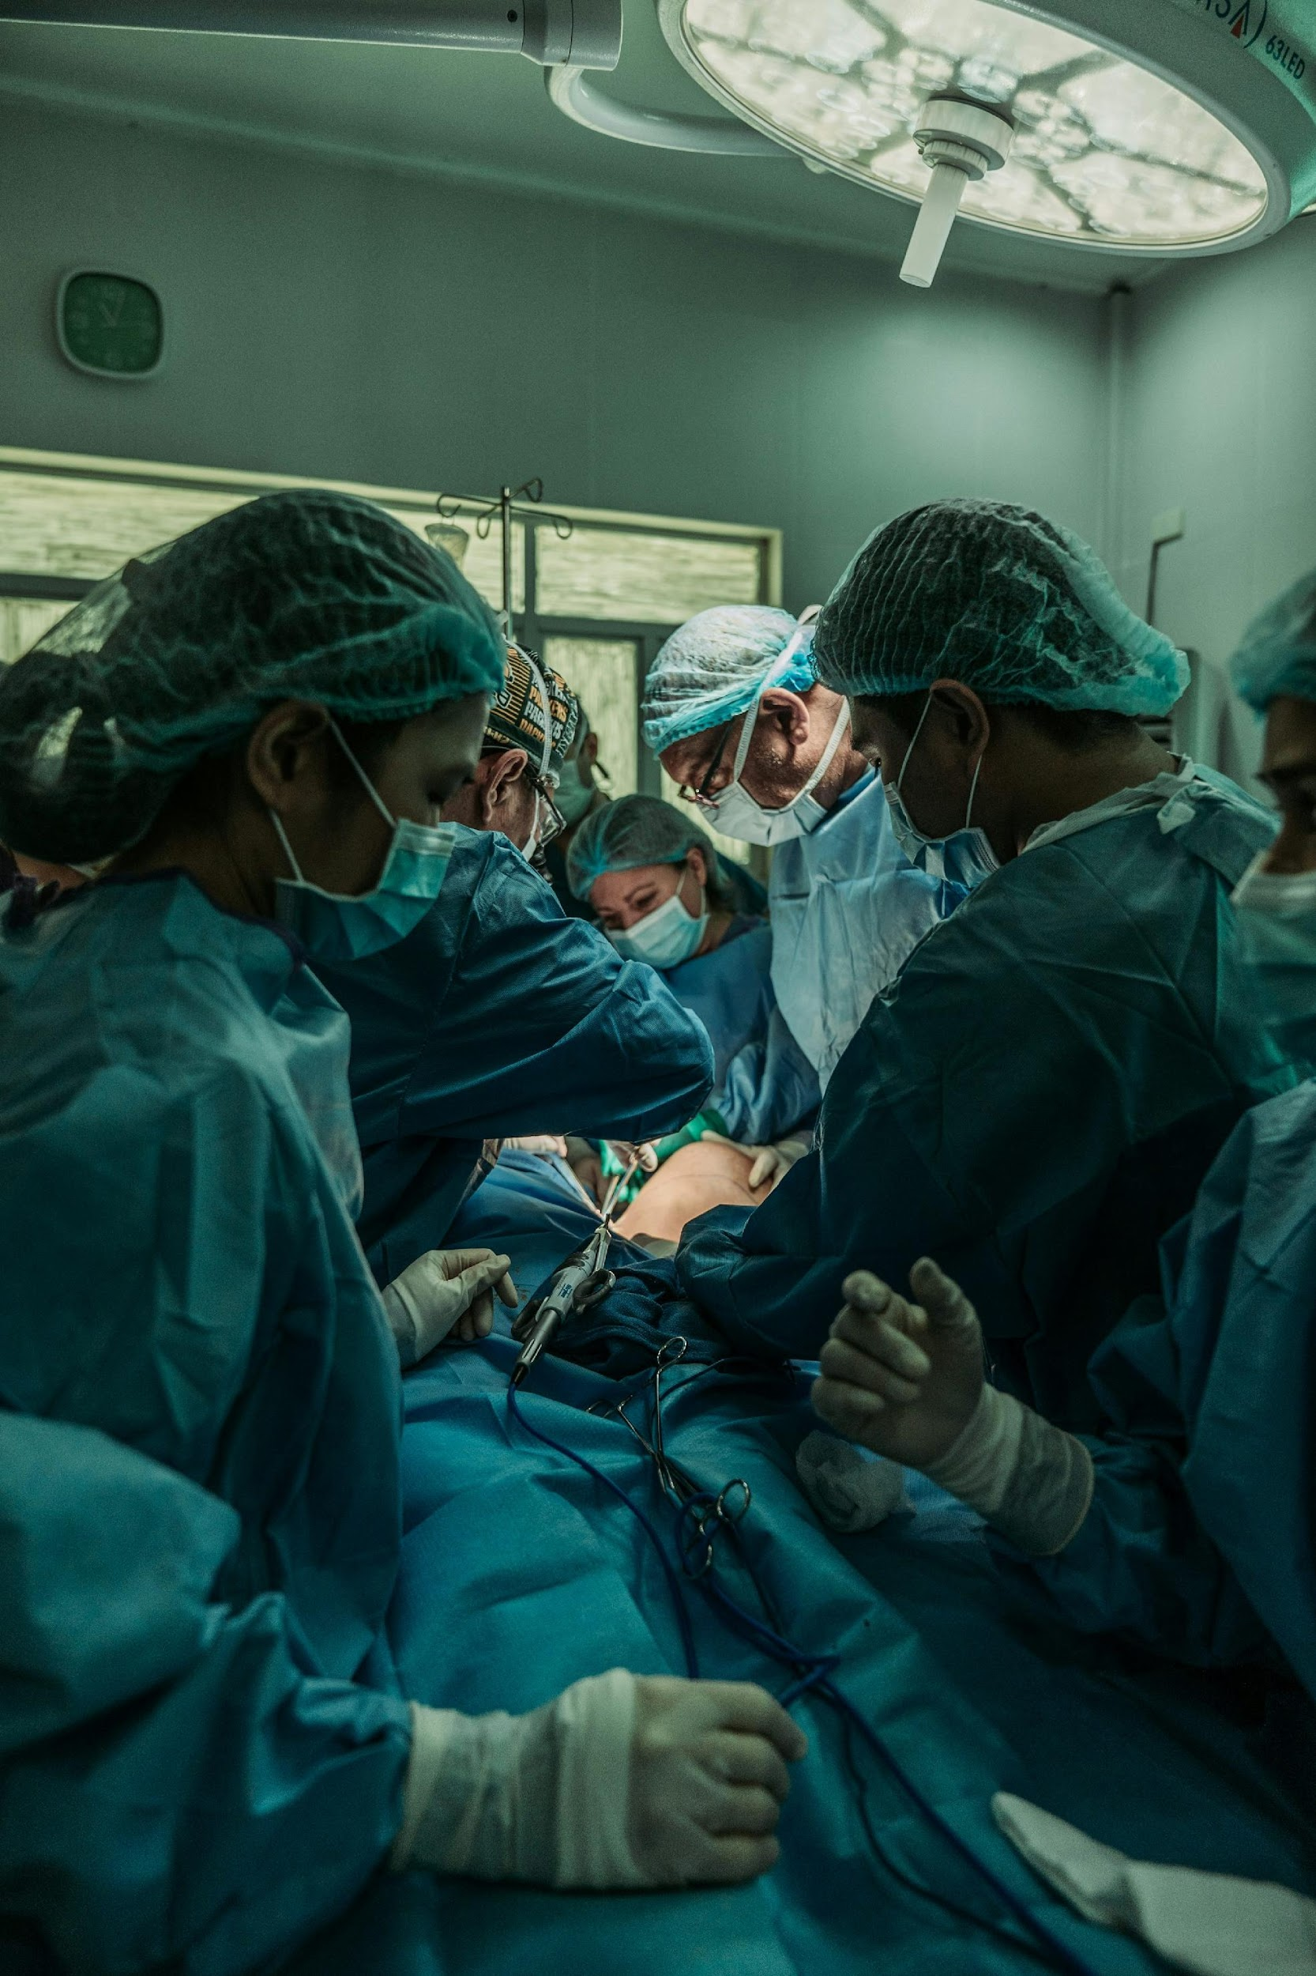

Case Study Overview
Introduction to the Business
National Hospital is a leading healthcare institution dedicated to the continual enhancement of patient care services through innovative approaches. Acknowledging the transformative potential of data-driven insights, the hospital has embarked on a strategic initiative to harness the power of its extensive medical records. The Hospital plans to leverage cloud technologies to propel healthcare research, with a primary focus on disease prediction, prevention, and better patient care/experience.

Slide 3
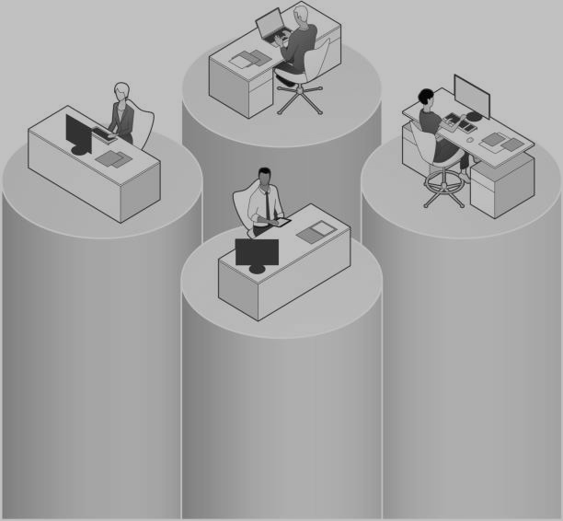
Case Study Overview
Problem Statement
The business faces a major challenge, as its data currently sits in silos across different departments. The Hospital recognizes the need to adopt cutting-edge solutions to effectively integrate, analyze and extract meaningful insights from vast and diverse medical datasets they collect. Traditional methods of data processing are proving inadequate in the face of the growing volume of patient and medical records. To address this challenge, the hospital is implementing a data analytics solution on Azure, to enable seamless and efficient querying and analysis of medical data.

Slide 4





Rationale for the Project
(What is the Importance of the project to the business)
1.
2.
3.
The primary rationale for the project is to overcome the challenge of fragmented, siloed data spread across various hospital departments. These data silos hinder the hospital’s ability to gain comprehensive insights, slowing down decision-making and potentially leading to missed opportunities for improving patient outcomes.
Traditional data processing methods are no longer sufficient to handle the ever-growing volume and complexity of patient data. Azure's cloud-based infrastructure offers the scalability and flexibility needed to process and store vast datasets efficiently, allowing the hospital to grow and collect more data, with minimal friction.
By centralizing and automating data processes in the cloud, the hospital can reduce the manual effort currently spent on data collection, integration, and processing. This will lead to greater operational efficiency and lower costs associated with managing fragmented data systems.

Slide 5
Case Study Objectives
Data Collection and Ingestion
Understand how to set up data ingestion activities on Azure data factory. Ingestion from on-prem databases or flat files
2. Data Cleaning and Transformation
Learn techniques for cleaning and transforming data using Databricks or stored procedures
3. Data Warehousing and Storage Optimization
Gain insights into modeling and developing a scalable storage solution to organize data efficiently and ensure easy access for analysis using Azure SQL databases or Synapse analytics.

Slide 6
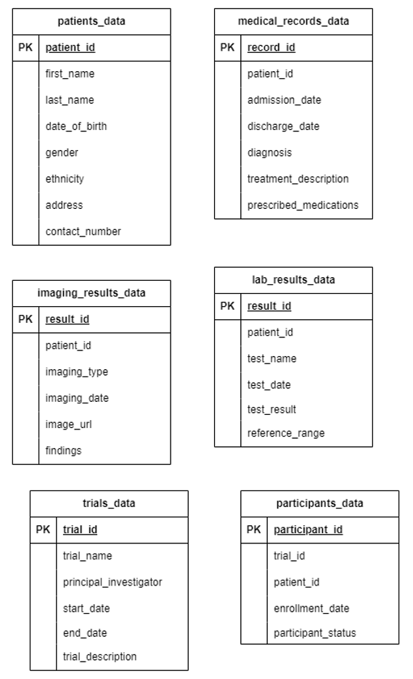
Data Description
This hospital data is a set of 6 csv files, from 4 departments. The departments and their files are: (Access files here)
Registration Department – Patients.csv
Consultation and Medical Department – medical_records.csv
Lab and Scan department – imaging_results_data.csv and lab_results_data.csv
R&D department – trials_data.csv and participants_data.csv

Slide 7
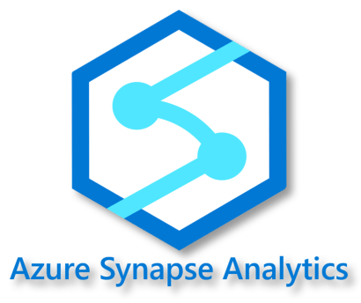
Tech Stack
Azure Data Lake
Storage Gen2

Slide 8
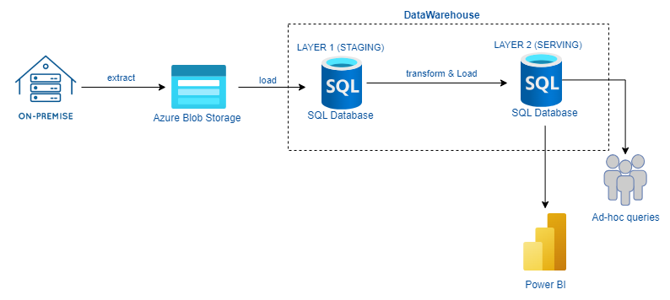
Pipeline Architecture

Slide 9
Project Workflow
STEP 1
Design a dimensional data model (OLAP) for the hospital
STEP 2
Load the given data to a data lake/blob storage on Azure cloud
Create a Datawarehouse in Azure SQL Database (or Azure Synapse Analytics) with two Schema – STG and EDW
STEP 3
Build a Pipeline on Azure Data Factory to copy the given files from your blob storage to tables on the Staging Schema of your data warehouse
STEP 4
STEP 5
Add a Databricks activity in your pipeline to transform the data in the staging tables into your designed data warehouse model. Store the transformed data in your data lake storage
Add a copy activity to load the transformed data to your production schema (EDW) on the data warehouse
STEP 6

Slide 10
Project Workflow
STEP 7
Run queries against your Datawarehouse to test its efficiency.
STEP 8
Schedule your pipeline to refresh your Datawarehouse daily.
STEP 9
Implement proper logging and data quality checks in your pipeline
Recommend operational process changes/optimizations to improve the data quality of the hospital.
STEP 10

Slide 11

READY TO
DELVE IN?

